Slide 1
Web Application Development ISCG7420 Introduction to Web Development
School of Computing, Electrical and Applied Technology

Slide 2
Outlines – React JS
Fragments
Router
Context API
Hooks
Using the State Hook
Using the Effect Hook & axios
useContext
useReducer

Slide 3
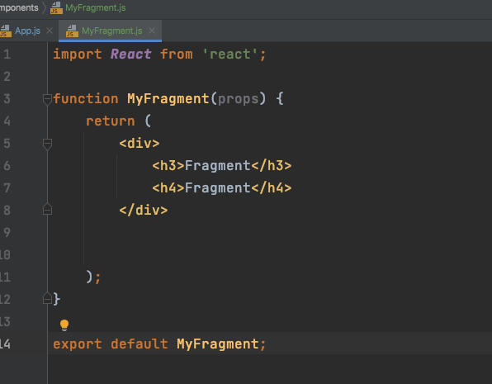
Fragments
https://reactjs.org/docs/fragments.html
Return multiple elements
Create a new file “MyFragment” and add it to your app.js

Slide 4
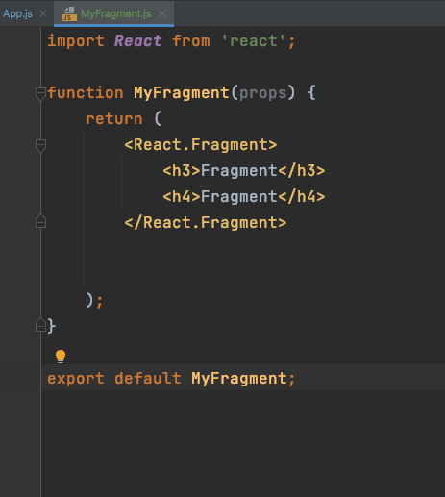

React.Fragment

Slide 5
Router
https://www.npmjs.com/package/react-router-dom
npm install --save react-router-dom
In index.js, import BrowserRouter, Route and Link

Slide 6
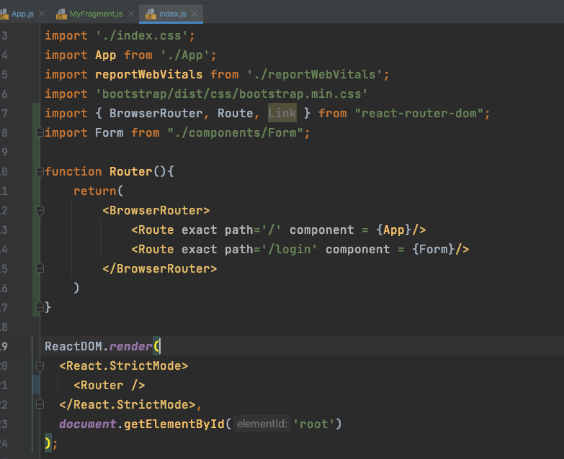
index.js

Slide 7
Context API
https://reactjs.org/docs/context.html
Like a global variable in whole website.
Create “ContextExample1”
Create “ContextExample2”
Add “ContextExample2” to “ContextExample1”
Add “ContextExample1” to “APP”
Create a react context in “APP”
Create a context provider in return
Add a value on context provider
Include the files the context providing for
In Context Examle2, add context Consumer with data

Slide 8
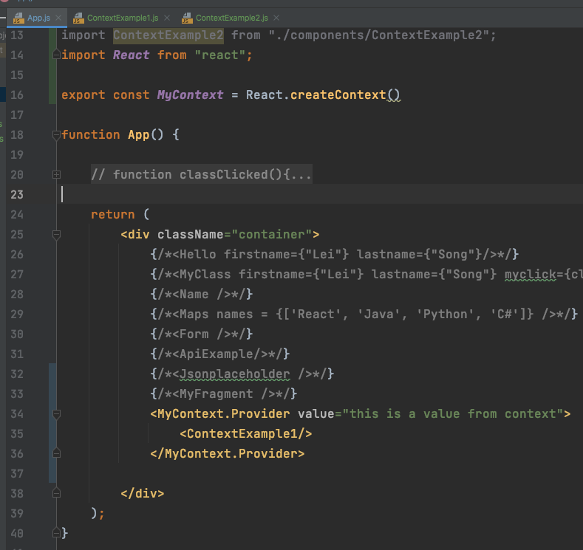
App.js

Slide 9
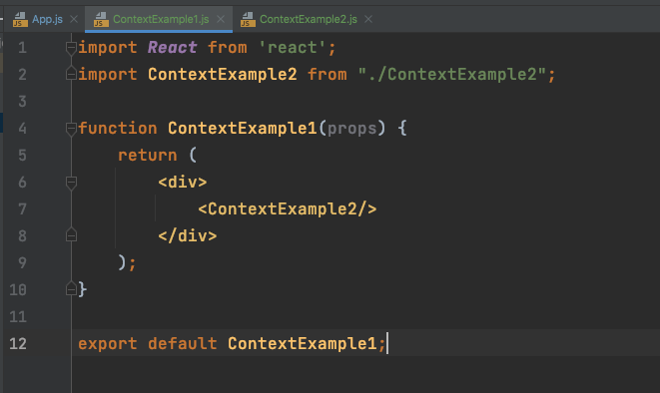
ContextExample1

Slide 10
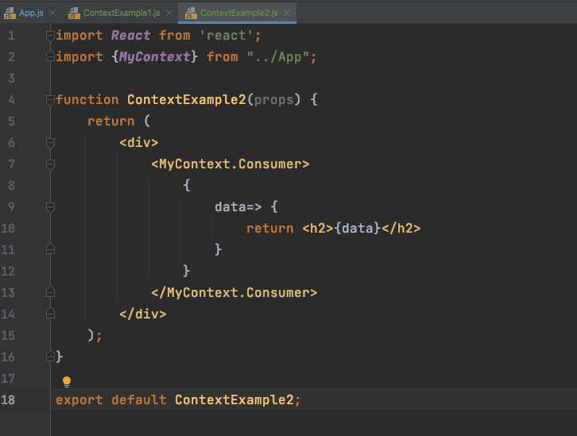
ContextExample2

Slide 11
Using the State Hook
https://reactjs.org/docs/hooks-state.html
let you use state and other React features without writing a class.
Create a ”Counter” file
Add “Counter” to ”APP”

Slide 12
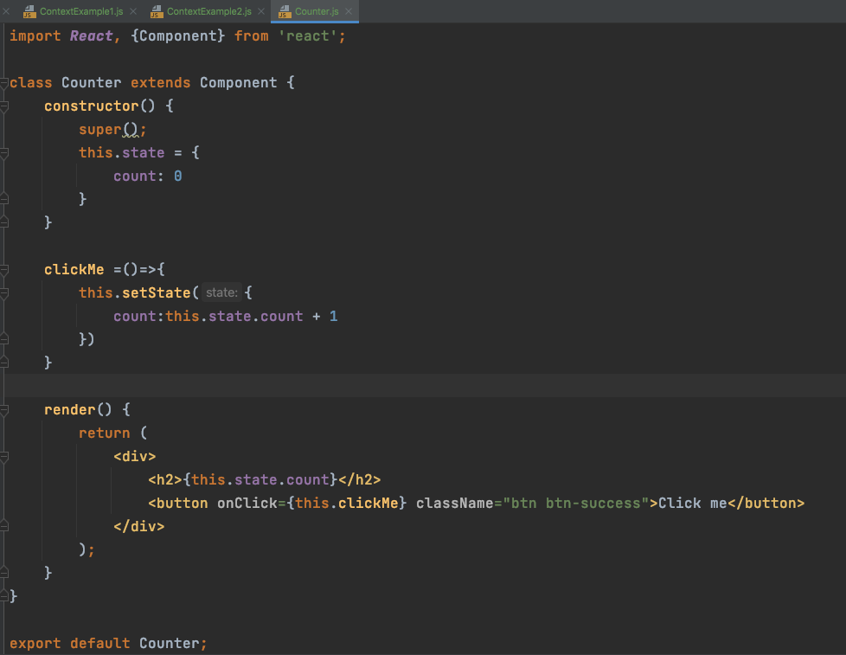
Counter.js

Slide 13
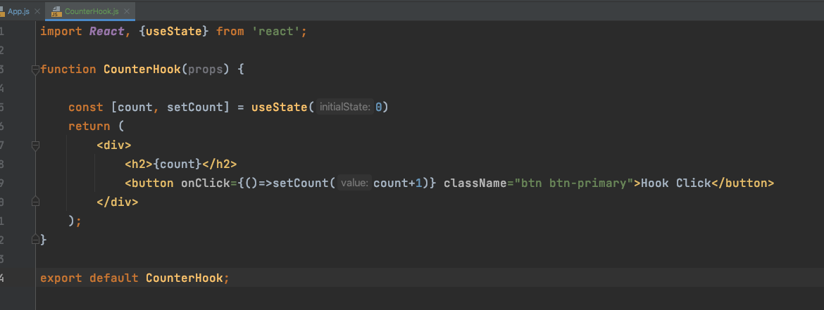
Use state hooks
Create a ”CounterHook” file
Add “CounterHook” to ”APP”

Slide 14
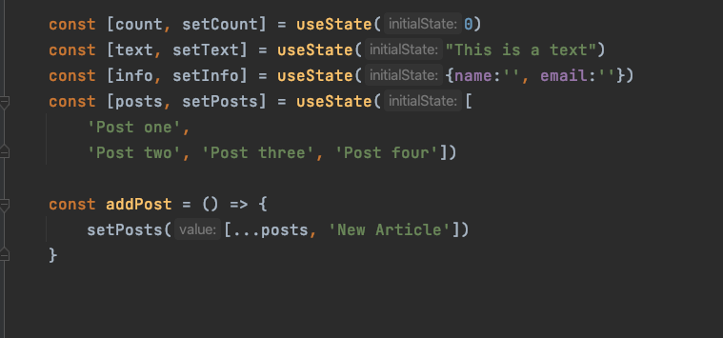
Add more hooks
String
Object
Array
Function for adding new items to array

Slide 15
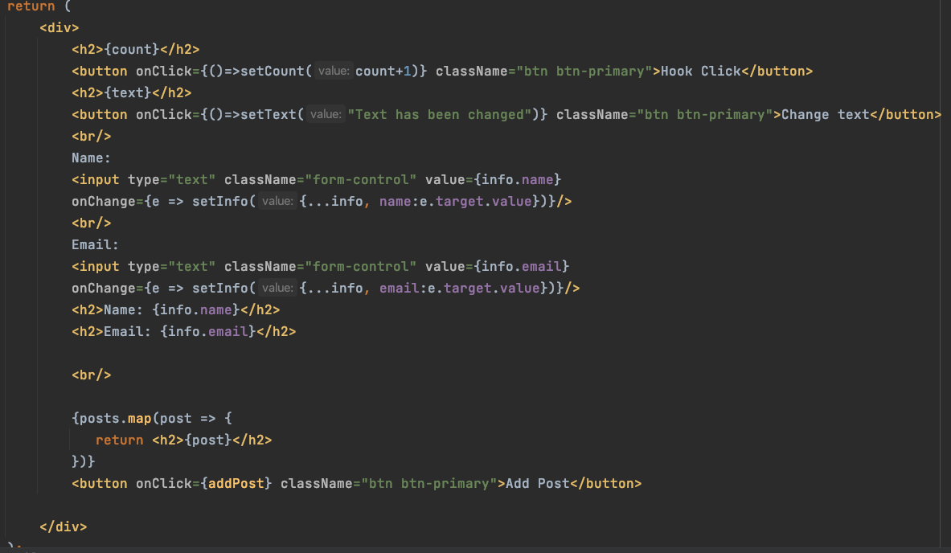
Add more hooks
String
Object
Adding to existing object
Adding to array

Slide 16
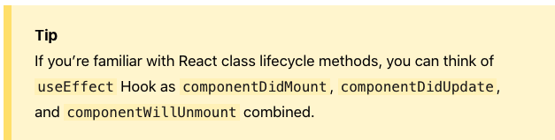
Using the Effect Hook
https://reactjs.org/docs/hooks-effect.html
The Effect Hook lets you perform side effects in function components:

Slide 17

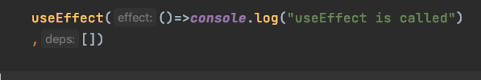

Try this in “CounterHook”

Slide 18
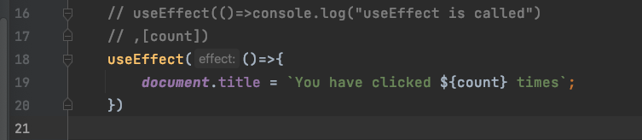
Effect by variable

Slide 19
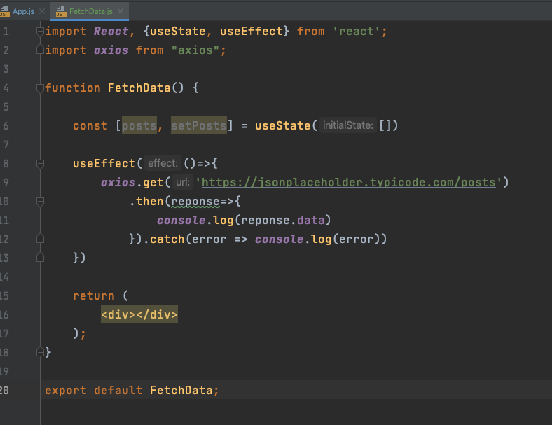
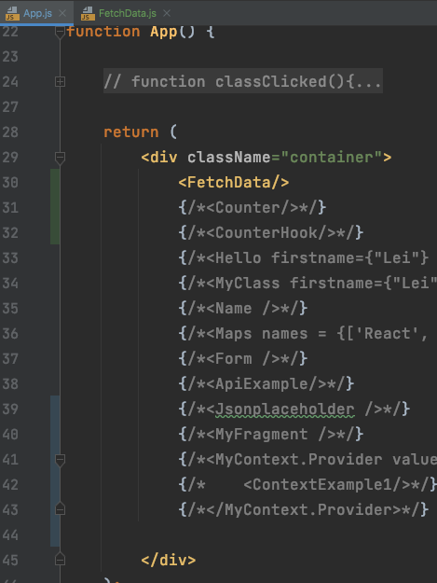
axios
https://www.npmjs.com/package/axios

Slide 20
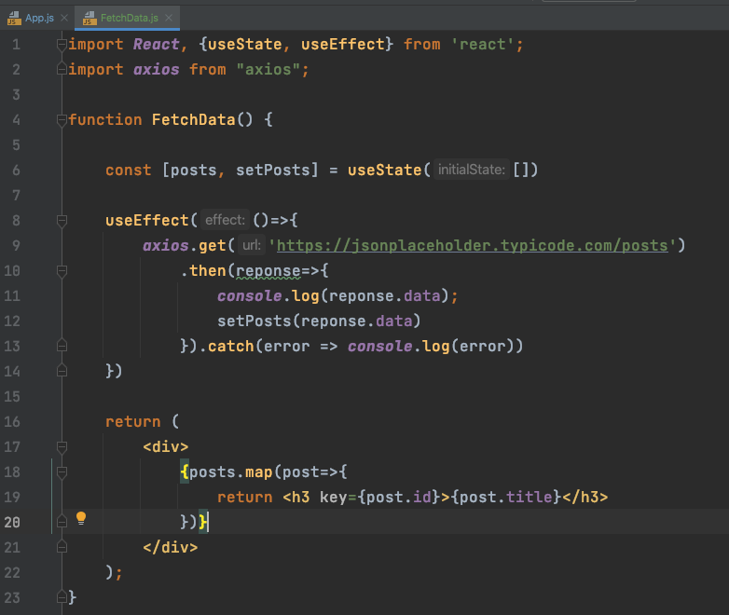
Get data from jsonplaceholder
What do you need here?
But something is not good on webpage

Slide 21
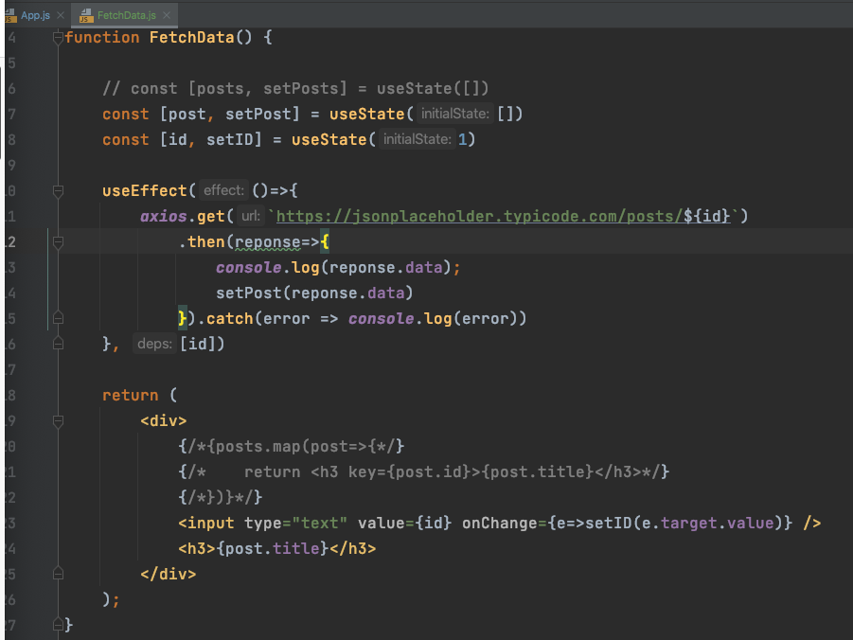
Fetch single post

Slide 22
useContext
https://reactjs.org/docs/hooks-reference.html#usecontext
Create Context in App.js
Create context provider for the files we want to share these contexts
Retrieve data in a nest file

Slide 23
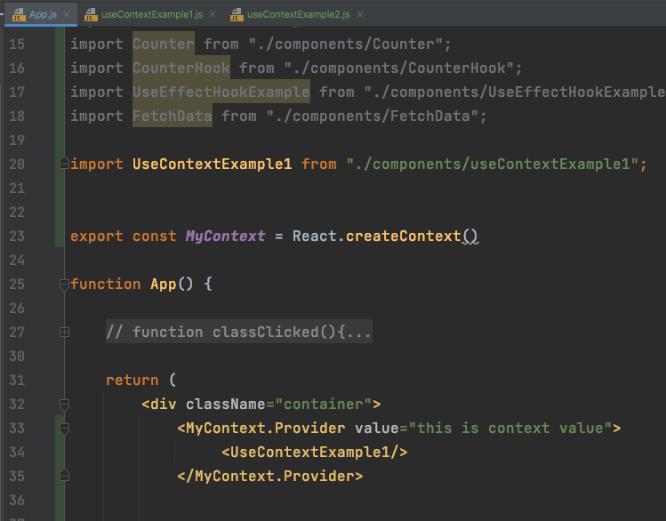
App.js

Slide 24
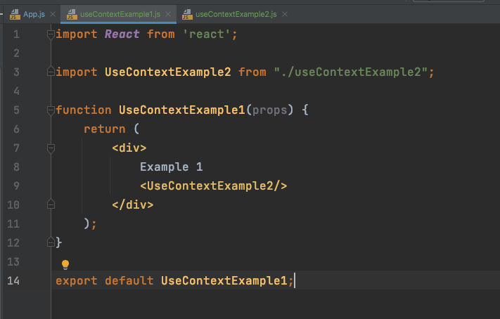
Example1.js

Slide 25
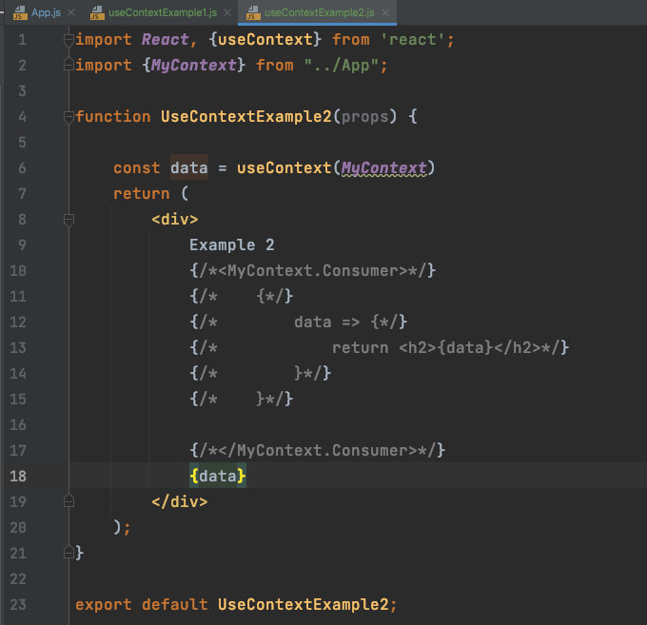
Example2.js

Slide 26
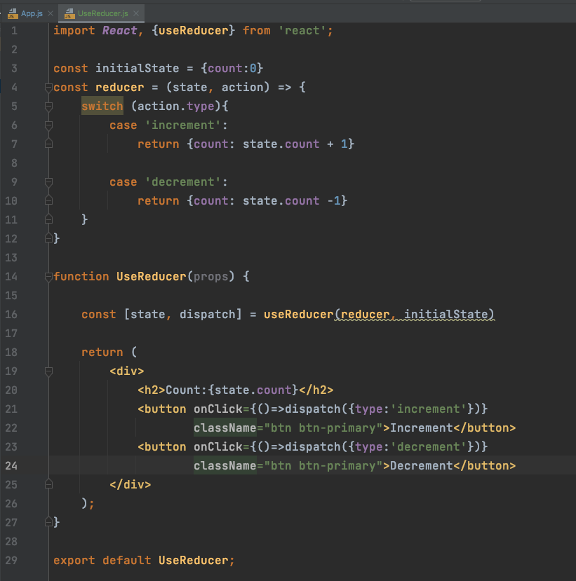
useReducer
https://reactjs.org/docs/hooks-reference.html#usereducer

Slide 27
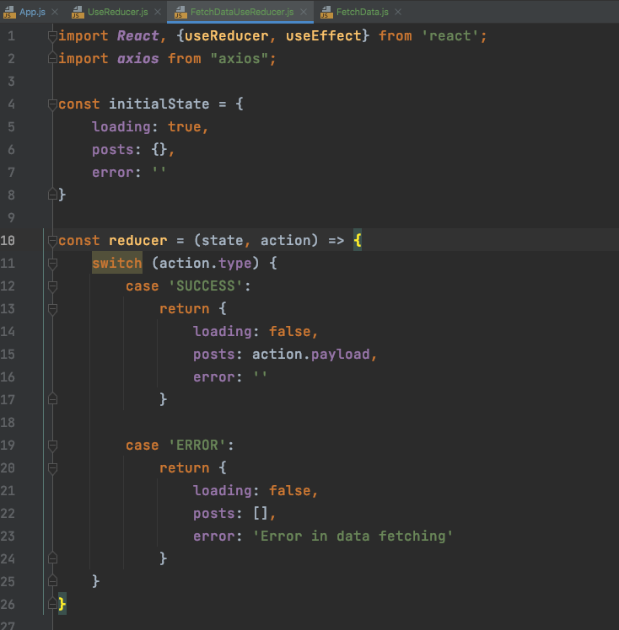
useReducer & useState Fetch Data

Slide 28
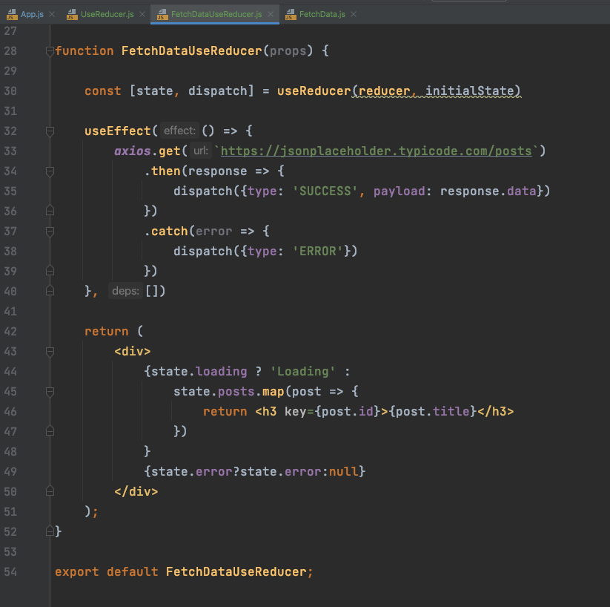
useReducer & useState Fetch Data

Slide 29
Source
https://www.youtube.com/watch?v=VBqJ0-imSMU&ab_channel=ParwizForogh

